Slide 1
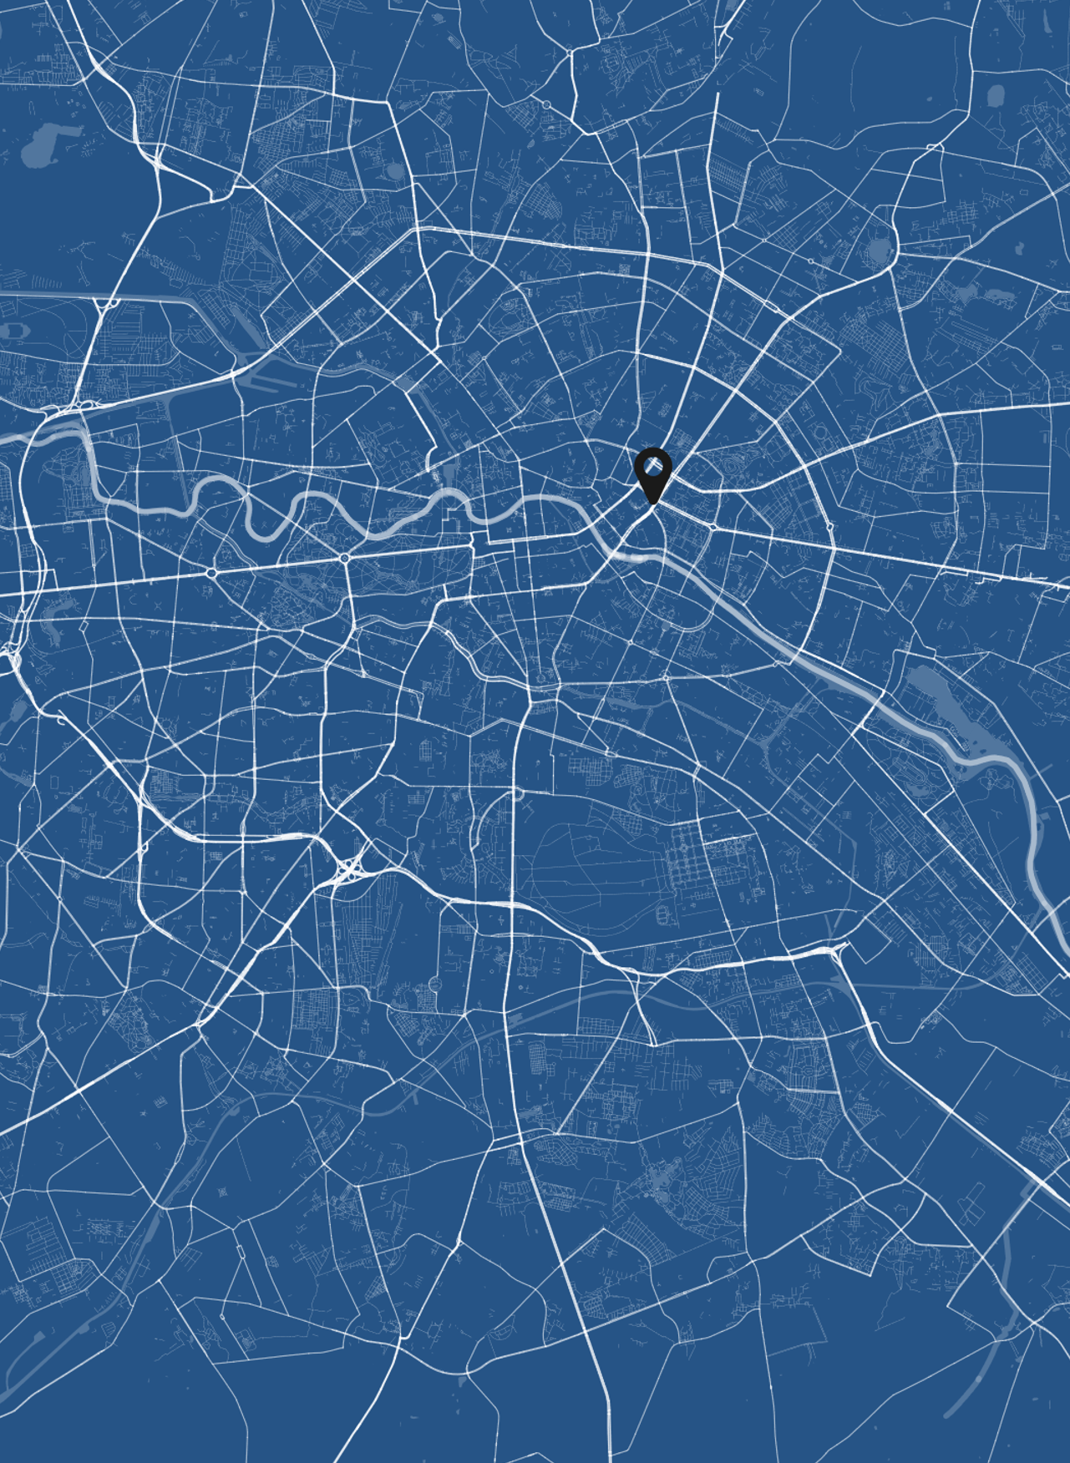
BERLIN
ALEMANIA
52°30'23.5"N/ 13°08'40.4"E

